Slide 1
Data independence
Lecture no 5
12/03/2024
Ayesha jarral

Slide 2
Introduction
Data Independence is mainly defined as a property of DBMS that helps you to change the database schema at one level of a system without requiring to change the schema at the next level. it helps to keep the data separated from all program that makes use of it. We have namely two levels of data independence arising from these levels of abstraction:
Physical level data independence
Logical level data independence

Slide 3
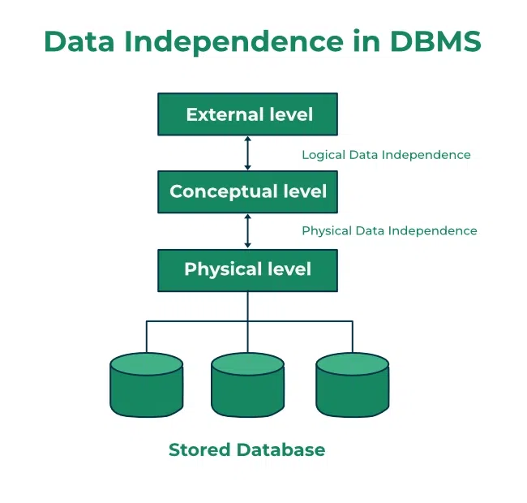
Data independence in DBMS

Slide 4
Logical Level Data Independence
It refers characteristic of being able to modify the logical schema without affecting the external schema or application program. The user view of the data would not be affected by any changes to the conceptual view of the data. These changes may include insertion or deletion of attributes, altering table structures entities or relationships to the logical schema, etc.
users cannot manipulate the logical structure of the database.
The changes in the logical level may include −
Change the data definition.
Adding, deleting, or updating any new attribute, entity or relationship in the database.
Notes:
2 type ki data independence use kia logical agar mein comcpetual level pr kon sa table use kr rahy kitn e tables hei attributes kitne hein lets say student table cloum hai name aur age ka user ko hum ny kia dheeka rahka hai name and age lets say user 1 ny new coloum add kr raha let say mobile 1 it will not effect the application program user one ju changing cha raha wo hum usko de rahy magar application program mein koi change nai hu raha

Slide 5
Physical Level Data Independence
Physical Data Independence means changing the physical level without affecting the logical level or conceptual level. Using this property, we can change the storage device of the database without affecting the logical schema.
The changes in the physical level may include changes using the following −
A new storage device like magnetic tape, hard disk, etc.
A new data structure for storage.
A different data access method or using an alternative files organization technique.
Changing the location of the database.
Notes:
DATABASEko hard disk one mein rhakha hua it doesn’t means k harddrive change ki to database ka conceptual level pr effect kry ga google have so much storage kia lgat hy uska data sara auk hi jaga para hu ahu ga nahi unho ny buht sara data shift kia hu ga

Slide 6
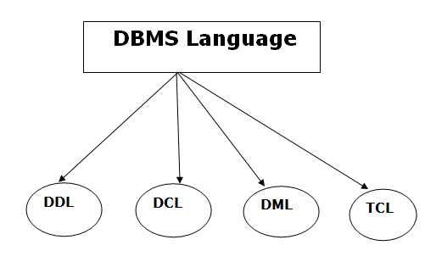
Database Languages in DBMS
A DBMS has appropriate languages and interfaces to express database queries and updates.
Database languages can be used to read, store and update the data in the database.
Data Definition Language (DDL)
DDL stands for Data Definition Language. It is used to define database structure or pattern.
It is used to create schema, tables, indexes, constraints, etc. in the database.
Using the DDL statements, you can create the skeleton of the database.
Data definition language is used to store the information of metadata like the number of tables and schemas, their names, indexes, columns in each table, constraints, etc.
Notes:
Metadata is essentially data about data. It provides information about various aspects of the data, helping users understand its context, structure, and characteristics. Here's a simplified explanation:
Explanation: Metadata serves as a descriptor or summary of the data, providing insights into its content, quality, and usage. It helps users locate, understand, and manage data effectively.
Simple Example:In photography, the metadata of an image includes details like the camera settings (aperture, shutter speed, ISO), the date and time the photo was taken, location coordinates (if available), and even the camera model. This metadata helps photographers organize and analyze their photos.

Slide 7
Here are some tasks that come under DDL:
Create: It is used to create objects in the database.
Alter: It is used to alter the structure of the database.
Drop: It is used to delete objects from the database.
Truncate: It is used to remove all records from a table.
Rename: It is used to rename an object.
Comment: It is used to comment on the data dictionary.

Slide 8
Data Manipulation Language (DML)
DML stands for Data Manipulation Language. It is used for accessing and manipulating data in a database. It handles user requests.
Here are some tasks that come under DML:
Select: It is used to retrieve data from a database.
Insert: It is used to insert data into a table.
Update: It is used to update existing data within a table.
Delete: It is used to delete all records from a table.
Merge: It performs UPSERT operation, i.e., insert or update operations.
Call: It is used to call a structured query language or a Java subprogram.
Explain Plan: It has the parameter of explaining data.
Lock Table: It controls concurrency.

Slide 9
DCL (Data Control Language).
It is used to retrieve the stored or saved data.
The DCL execution is transactional. It also has rollback parameters.
(But in Oracle database, the execution of data control language does not have the feature of rolling back.)
Here are some tasks that come under DCL:
Grant: It is used to give user access privileges to a database.
Revoke: It is used to take back permissions from the user.
There are the following operations which have the authorization of Revoke:
CONNECT, INSERT, USAGE, EXECUTE, DELETE, UPDATE and SELECT.
Notes:
DCL is responsible for managing user access and permissions within a database. The "Grant" command is used to give specific privileges to users, while the "Revoke" command is used to take away those privileges. These commands ensure proper control and security over the database by regulating user access to data.

Slide 10
Transaction Control Language (TCL)
TCL is used to run the changes made by the DML statement. TCL can be grouped into a logical transaction.
Here are some tasks that come under TCL:
Commit: It is used to save the transaction on the database.
Rollback: It is used to restore the database to original since the last Commit.

Slide 11
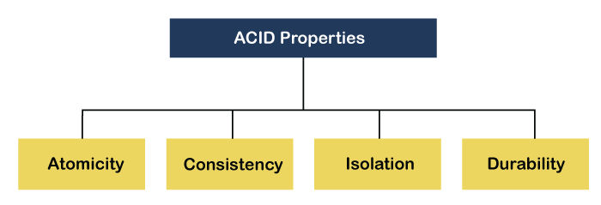
Acid properties
DBMS is the management of data that should remain integrated when any changes are done in it. It is because if the integrity of the data is affected, whole data will get disturbed and corrupted.
Therefore, to maintain the integrity of the data, there are four properties described in the database management system, which are known as the ACID properties.
The ACID properties are meant for the transaction that goes through a different group of tasks, and there we come to see the role of the ACID properties.

Slide 12
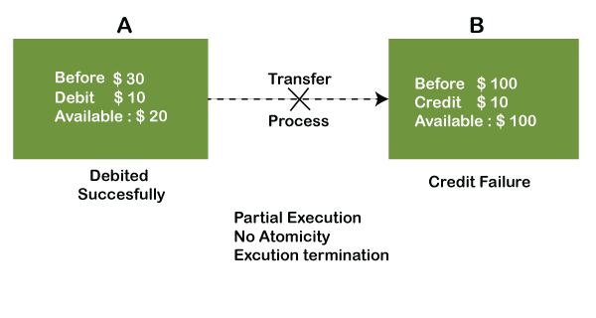
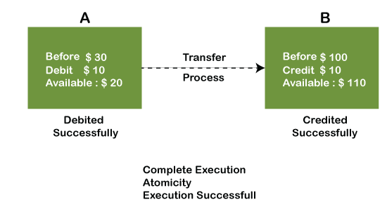
Atomicity
The term atomicity defines that the data remains atomic.
It means if any operation is performed on the data, either it should be performed or executed completely or should not be executed at all.
It further means that the operation should not break in between or execute partially. In the case of executing operations on the transaction, the operation should be completely executed and not partially.
Notes:
In the above diagram, it can be seen that after crediting $10, the amount is still $100 in account B. So, it is not an atomic transaction.
The below image shows that both debit and credit operations are done successfully. Thus the transaction is atomic.

Slide 13
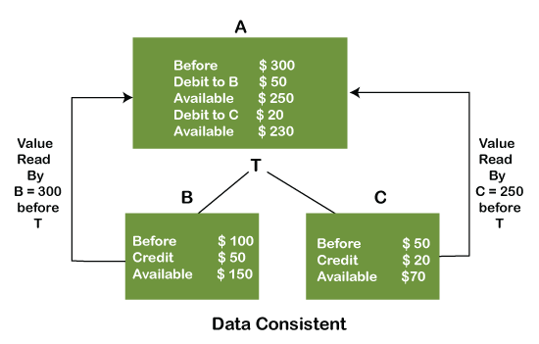
Consistency
The word consistency means that the value should remain preserved always.
In DBMS, the integrity of the data should be maintained, which means if a change in the database is made, it should remain preserved always.
In the case of transactions, the integrity of the data is very essential so that the database remains consistent before and after the transaction. The data should always be correct.
Notes:
For example, suppose you have $100 in your account, and you decide to withdraw $50. The bank's database needs to ensure that after the withdrawal, your account balance is updated correctly to $50. Similarly, if you deposit $20 later, the database needs to ensure that your balance is updated to $70.
Consistency ensures that even if multiple transactions occur simultaneously, the data remains accurate and the integrity of your account balance is maintained. Just like how your bank ensures that your account balance is always correct, DBMS ensures that the data in the database remains consistent and reliable at all times.

Slide 14
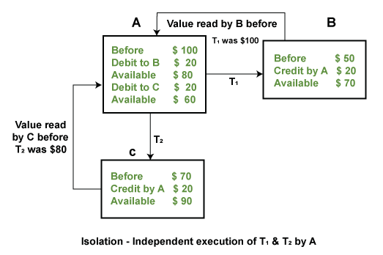
isolation
The term 'isolation' means separation. In DBMS, Isolation is the property of a database where no data should affect the other one and may occur concurrently.
In short, the operation on one database should begin when the operation on the first database gets complete. It means if two operations are being performed on two different databases, they may not affect the value of one another.
In the case of transactions, when two or more transactions occur simultaneously, the consistency should remain maintained. Any changes that occur in any particular transaction will not be seen by other transactions until the change is not committed in the memory.
Notes:
Example: If two operations are concurrently running on two different accounts, then the value of both accounts should not get affected. The value should remain persistent. As you can see in the below diagram, account A is making T1 and T2 transactions to account B and C, but both are executing independently without affecting each other. It is known as Isolation.

Slide 15
Durability
Durability ensures the permanency of something. In DBMS, the term durability ensures that the data after the successful execution of the operation becomes permanent in the database. The durability of the data should be so perfect that even if the system fails or leads to a crash, the database still survives. However, if gets lost, it becomes the responsibility of the recovery manager for ensuring the durability of the database. For committing the values, the COMMIT command must be used every time we make changes.
Therefore, the ACID property of DBMS plays a vital role in maintaining the consistency and availability of data in the database.

